Slide 1

PHYSICS
Subsystem that calculates collision and simulate physical actors.

Slide 2
COLLISIONS OVERVIEW
An overview of how Collision and Collision Responses operate in Unreal Engine

Slide 3

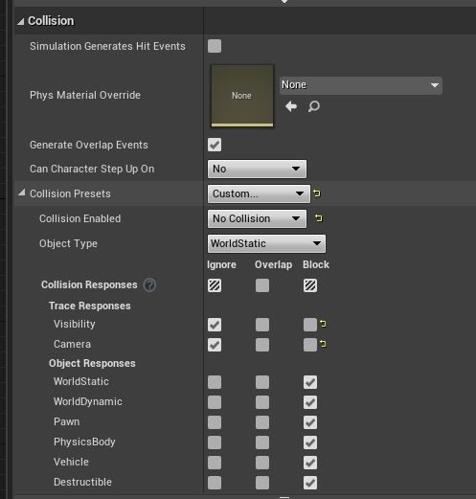
Collision Responses and Trace Responses form the basis for how Unreal Engine handles collision and ray casting during run time.
Every object that can collide gets an Object Type and a series of responses that define how it interacts with all other object types.
When a collision or overlap event occurs, both (or all) objects involved can be set to affect or be affected by blocking, overlapping, or ignoring each other.
Trace Responses work basically the same way, except the trace (ray cast) itself can be defined as one of the Trace Response types, thusly allowing Actors to either block it or ignore it based on their Trace Responses.
Responses

Slide 4
Blocking will naturally occur between two (or more) Actors set to Block.
However, Simulation Generates Hit Events needs to be enabled to execute Event Hit, which is used in Blueprints, Destructible Actors, Triggers, etc...
Setting Actors to Overlap will often look like they Ignore each other, and without Generate Overlap Events, they are essentially the same.
For two or more simulating objects to block each other, they both need to be set to block their respective object types.
For two or more simulating objects: if one is set to overlap an object, and the second object is set to block the other, the overlap will occur but not the block.
Overlap events can be generated even if an object Blocks another, especially if traveling at high speeds.
It is not recommended for an object to have both collision and overlap events. Though possible, there is much that needs manual handling.
If one object is set to ignore and the other is set to overlap, no overlap events will be fired.
All objects have Collision Enabled set to Collision Enabled so they are set to fully collide with everything. If collision is disabled, it is as if ignore has been set for all Collision Responses.
How Interactions Work

Slide 5
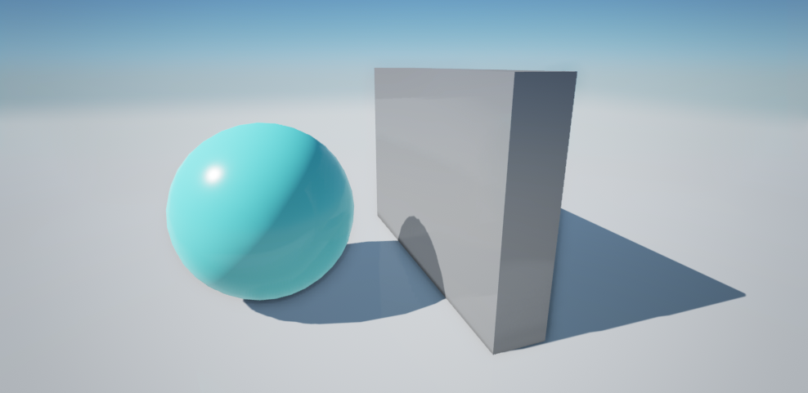
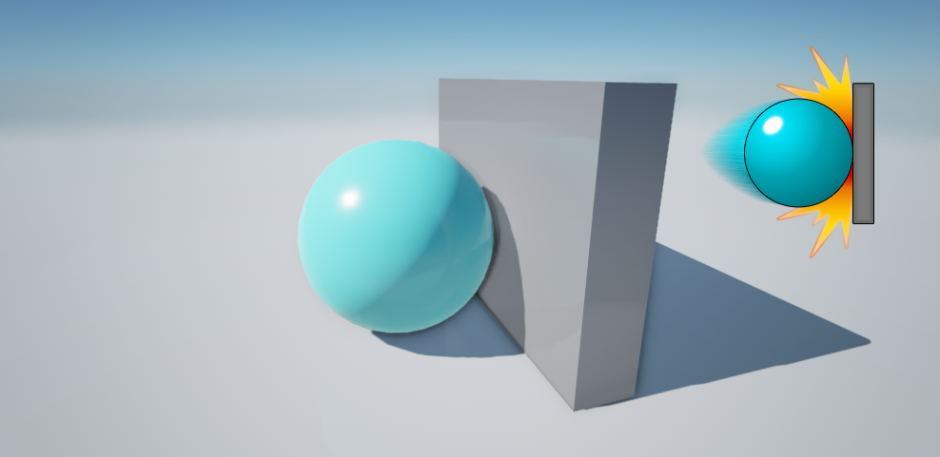
YOUR FIRST COLLISION(!)
The default Play In Editor camera is a pawn. Thusly can be blocked by anything set to block pawns.
The Simulate in Editor camera, before possessing anything, is not a pawn. It can freely clip through everything and will not create any collision or overlap events.
The sphere is a PhysicsBody and the box is WorldDynamic, and by changing their collision settings we can get a number of behaviors.
By setting both of their collision settings to block each other, you get a collision, great for having objects interact with each other:

Slide 6
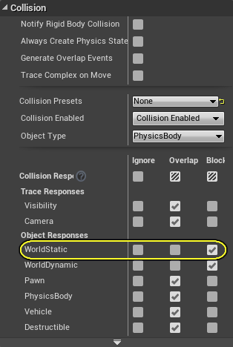
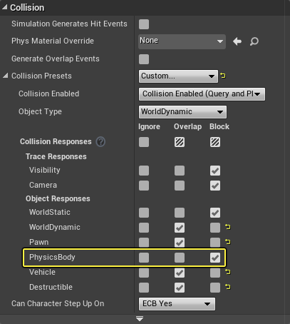
Sphere Collision Setup
YOUR FIRST COLLISION(!)
The default Play In Editor camera is a pawn. Thusly can be blocked by anything set to block pawns.
The Simulate in Editor camera, before possessing anything, is not a pawn. It can freely clip through everything and will not create any collision or overlap events.
The sphere is a PhysicsBody and the box is WorldDynamic, and by changing their collision settings we can get a number of behaviors.
By setting both of their collision settings to block each other, you get a collision, great for having objects interact with each other.
Enable Simulate Physics for the sphere to test the collision in Play (Simulate) mode.
Wall Collision Setup

Slide 7
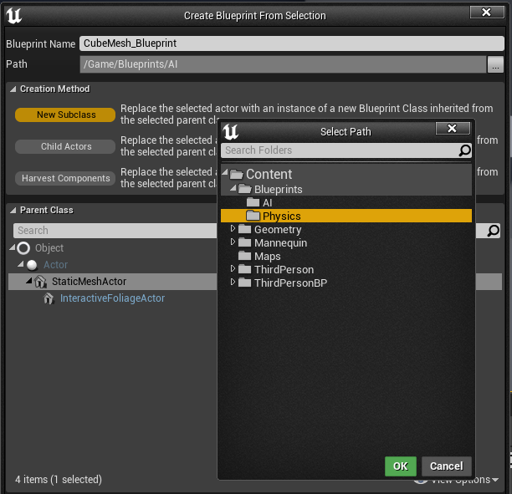
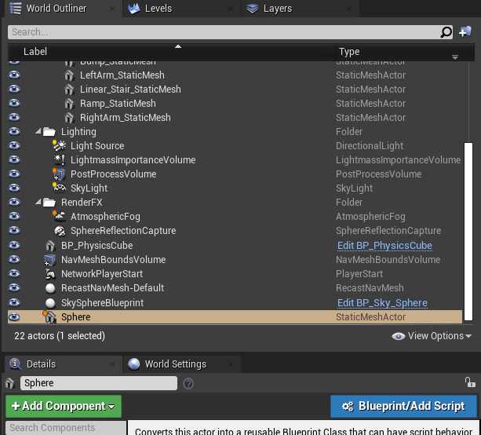
COLLISION EVENTS
With the sphere set to Simulation Generates Hit Events, the sphere will tell itself that it has had a collision. It will fire off events such as Hit or OnComponentHit in the sphere's Blueprint. Now if the box had an event for collision, it would not fire because it will never notify itself it has happened.
Further, an object that is reporting rigid collisions will report them all and spam reports when it is just sitting on something, so it is best to be careful to filter what it is colliding within its Blueprint or in code.
HOW WOULD YOU PLAY A SOUND WHEN THE SPHERE HIT SOMEWHERE?
Let’s convert sphere and cube meshes into blueprinted actors! (Use Add Blueprint/Script button in World Outliner)

Slide 8
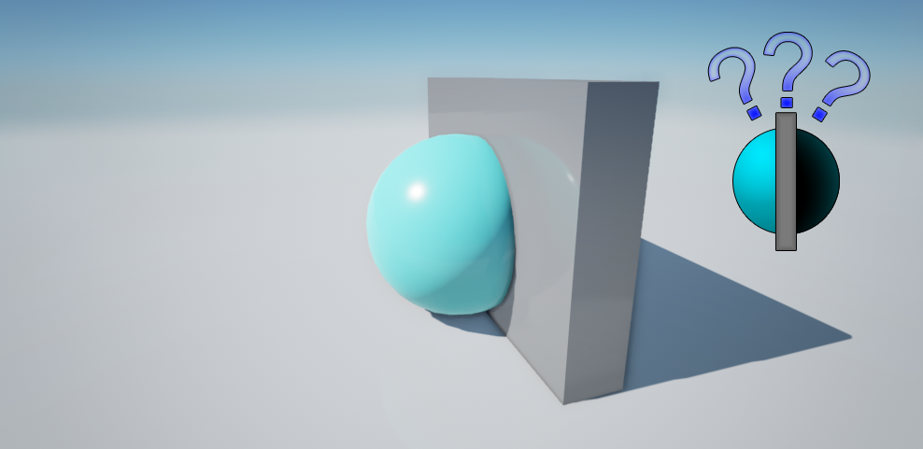
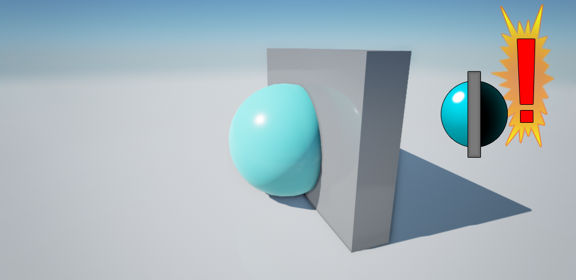
OVERLAP vs. IGNORE
For all intents and purposes, Overlap and Ignore work exactly the same assuming Generate Overlap Events is disabled. In this case, the sphere is set to overlap or ignore the box.
For an overlap to occur, both Actors need to enable Generate Overlap Events. This is for performance. In the case where both the Sphere and the Box want overlaps when we move either the Sphere or the Box, we do an overlap query to see if we need to fire any events.
If the Box doesn't want overlaps then when it moves we will not do an overlap query. But now we could be overlapping with the Sphere, and so the Sphere would need to tick and check for overlaps each frame in case someone moved into them.

Slide 9
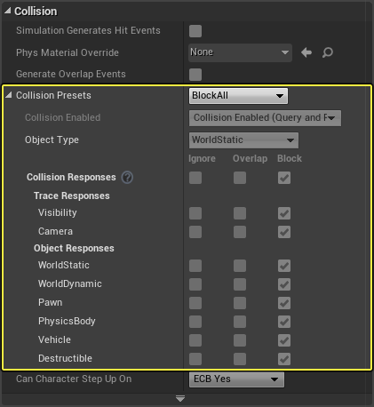
Property | Description
No Collision | This body Will have no representation in the physics engine. It cannot be used for spatial queries (raycasts, sweeps, overlaps) or simulation (rigid body, constraints). This setting gives the best performance possible, especially for moving objects.
Query Only | This body is used only for spatial queries (raycasts, sweeps, and overlaps). It cannot be used for simulation (rigid body, constraints). This setting is useful for character movement and objects that do not need physical simulation. Some performance gains are made by reducing the data in the physics simulation tree.
Physics Only | This body is only for physics simulation (rigid body, constraints). It cannot be used for spatial queries (raycasts, sweeps, overlaps). Some performance gains are made by reducing the data in the query tree.
Collision Enabled | This body can be used for both spatial queries (raycasts, sweeps, overlaps) and simulation (rigid body, constraints).
COLLISION ENABLED?

Slide 10
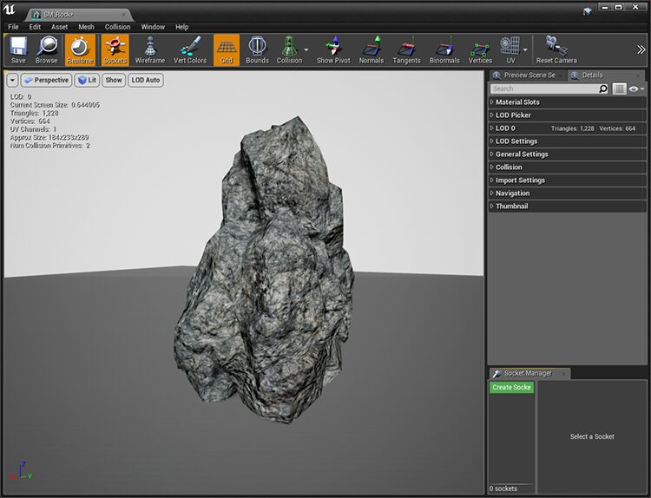
SETTING UP COLLISION GEOMETRY
Add a Collision Hull to a Static Mesh Using the Auto Convex Collision Tool
Add Simple Collision to a Static Mesh
Add a K-DOP collision hull to a Static Mesh
Add a Custom Object Type to Your Project
Review Collision in Our Game

Slide 11
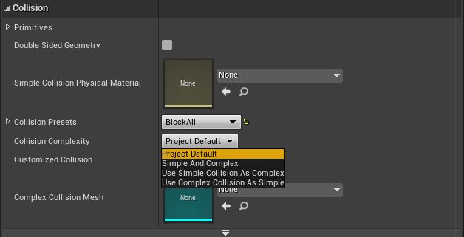
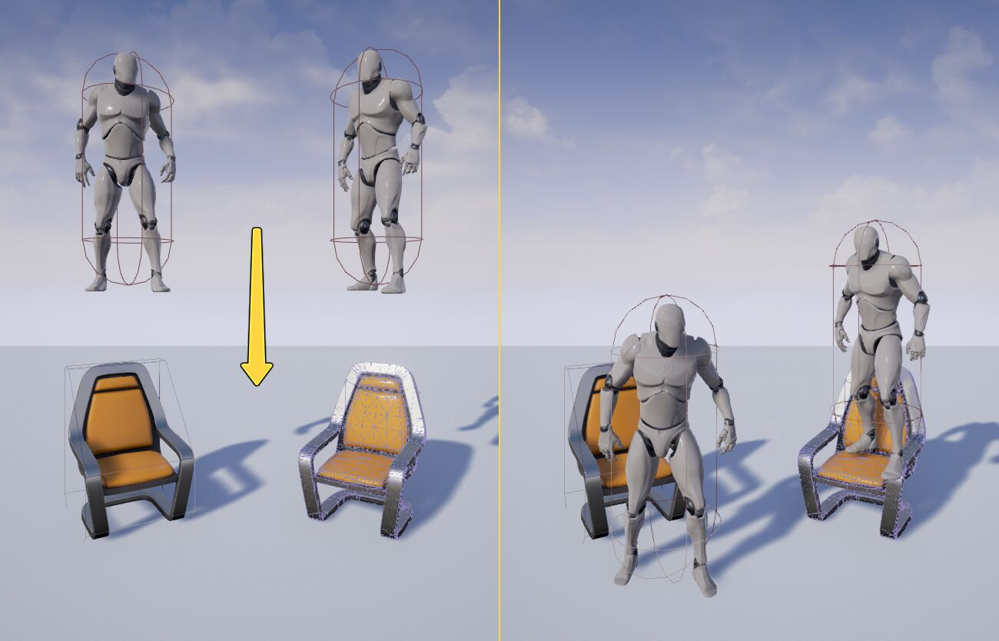
SIMPLE vs. COMPLEX COLLISION
In Unreal Engine, you have access to simple and complex collision shapes. Simple Collision are primitives like cubes, spheres, capsules, and convex hulls. Complex Collision is the trimesh of a given object.
By default, Unreal Engine creates both simple and complex shapes, then, based on what the user wants (complex query versus simple query), the physics solver will use the corresponding shape for scene queries and collision tests.

Slide 12
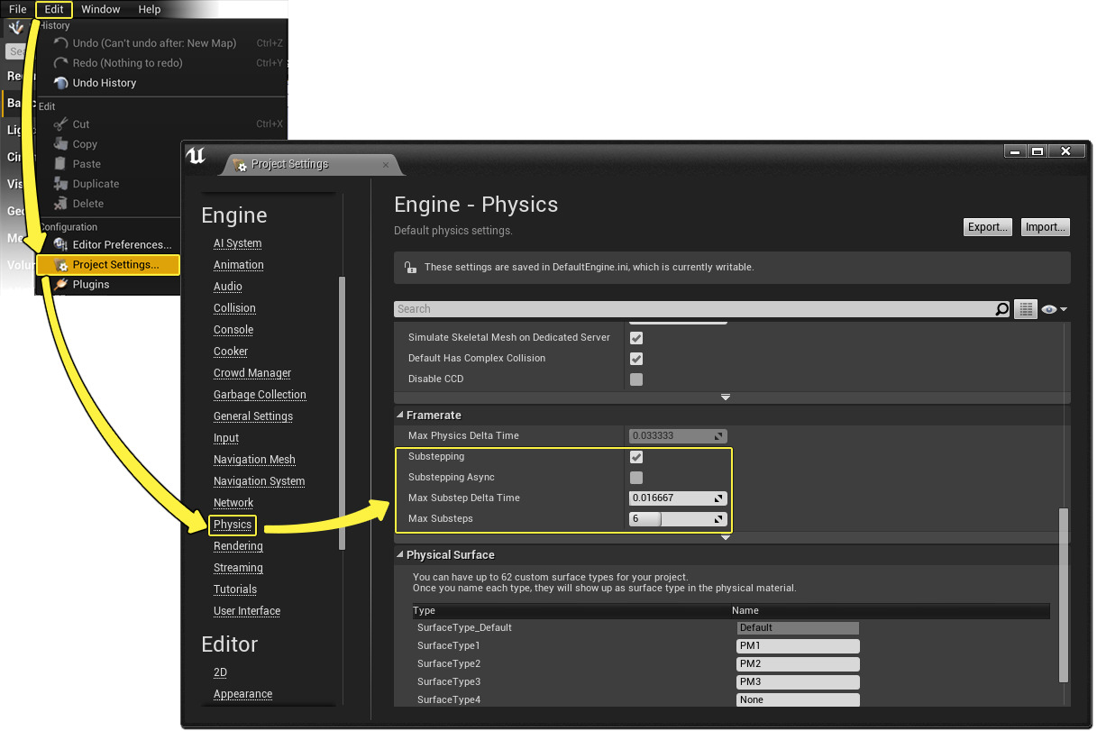
PHYSICS SUB-STEPPING
Sub-stepping will significantly improve the quality of complex physics assets, such as those used for rag doll. However, you should always weigh the improvement in quality to the CPU cost, and what is truly important to your game.
Unreal Engine uses a variable frame rate. While this is good for hardware scalability, it creates a challenge for the physics engine, which works best with small fixed time steps. Sub-stepping takes the total frame time and divides it into sub-steps. The physics simulation is then ticked multiple times per frame. The number of sub-steps taken will depend on how small your max sub-step delta time is set to. The smaller the max sub-step time the more stable your simulation will be, but at a greater CPU cost.

Slide 13
PHYSICS CONSTRAINTS
Constraining physics objects together and to the world.

Slide 14
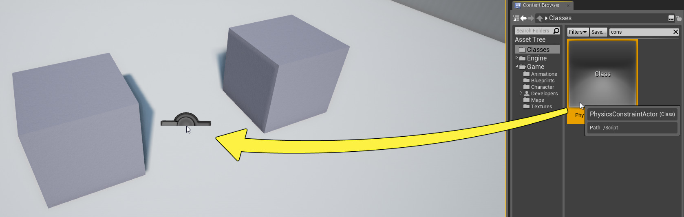
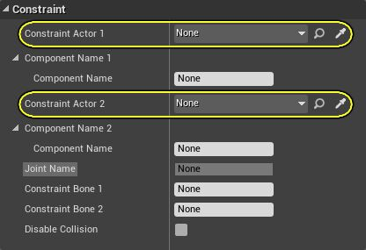
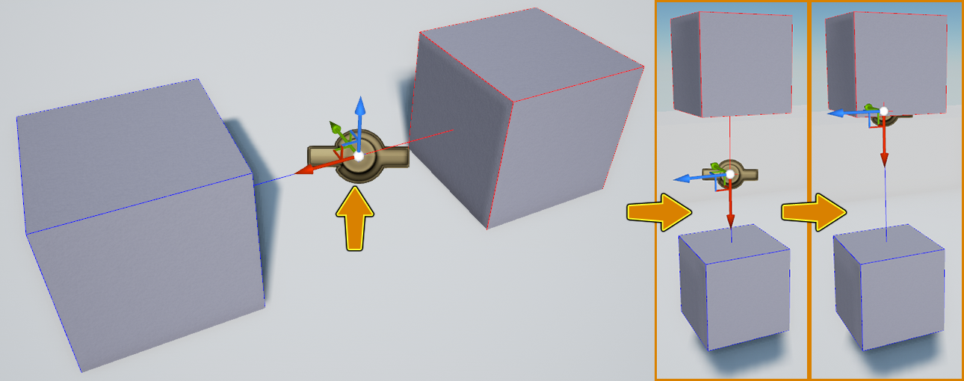
Physics Constraint Actor
A constraint is basically a type of joint. It allows you to connect two Actors together (presumably one physically simulating), and also apply limits or forces.
Unreal Engine has a very flexible and data-driven constraint system that allows designers to make many different types of joints simply by changing some options.
The engine has a few default joint types (ball-and-socket, hinge, prismatic) but they only differ in their settings.
You should feel free to start with any joint type and experiment with making your own configurations.

Slide 15
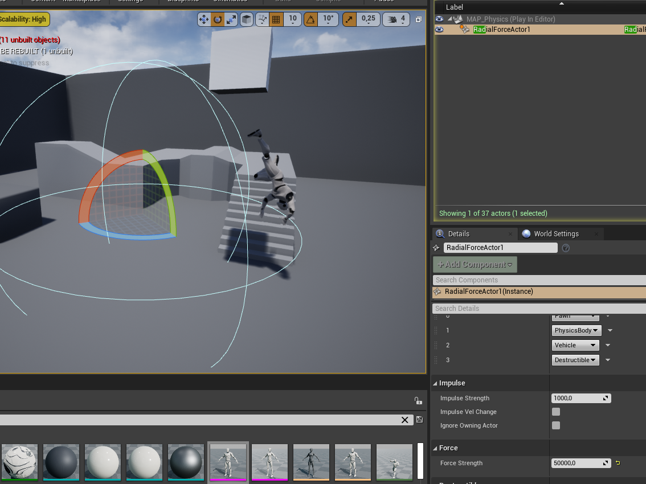
Physics Constraint Actor
Connecting bones to the constraints.
Angle Limits.
Applying radial forces.

Slide 16
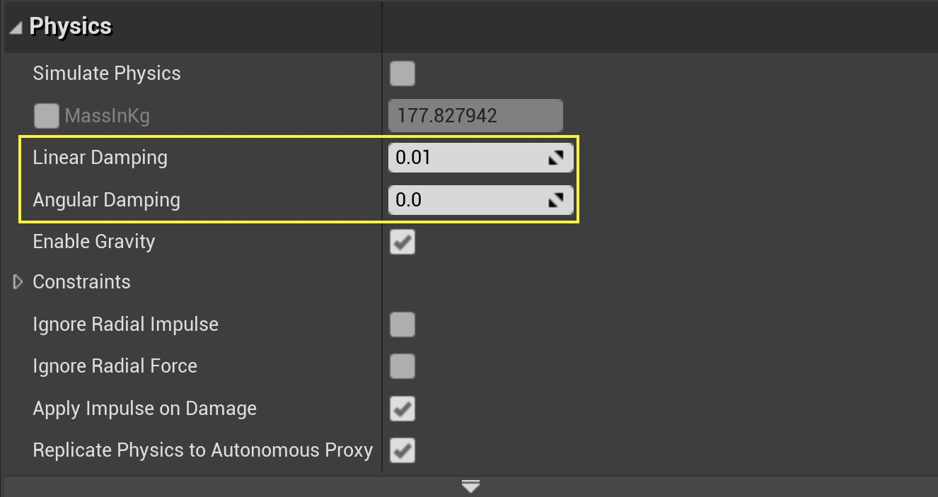
DAMPING AND FRICTION
To slow down Physics Bodies, simulate atmospheric drag, or add resistance to a hinge, there are two properties available to Physics Bodies and Physics Constraints: Linear Damping and Angular Damping.
Linear Damping controls how much the Physics Body or Constraint resists translation, while Angular Damping controls how much they resist rotating.
For reference, in normal gravity (9.8m/s^2), a Linear Damping value of 30 is enough to stop any single body Actor from falling under the initial pull of gravity, at the start of the simulation. Once more than one Physics Body is interacting (through the use of Physics Constraints or if a collision is occurring), the amount of damping required to stop the Physics Body goes up.
The minimum Linear Damping value to stop a Physics Body that has had force applied to it is around 100.
Finally, with no Angular Damping, a Physics Body will continue to rotate until it is acted upon by an outside force. Even small values can reduce rotation rapidly, while a value of 100 will almost immediately stop any angular motion caused by an outside source.

Slide 17
PHYSICS MATERIALS
Assets applied to physically simulated primitives, directly or via materials, used to configure and control physical properties used by the simulation.

Slide 18
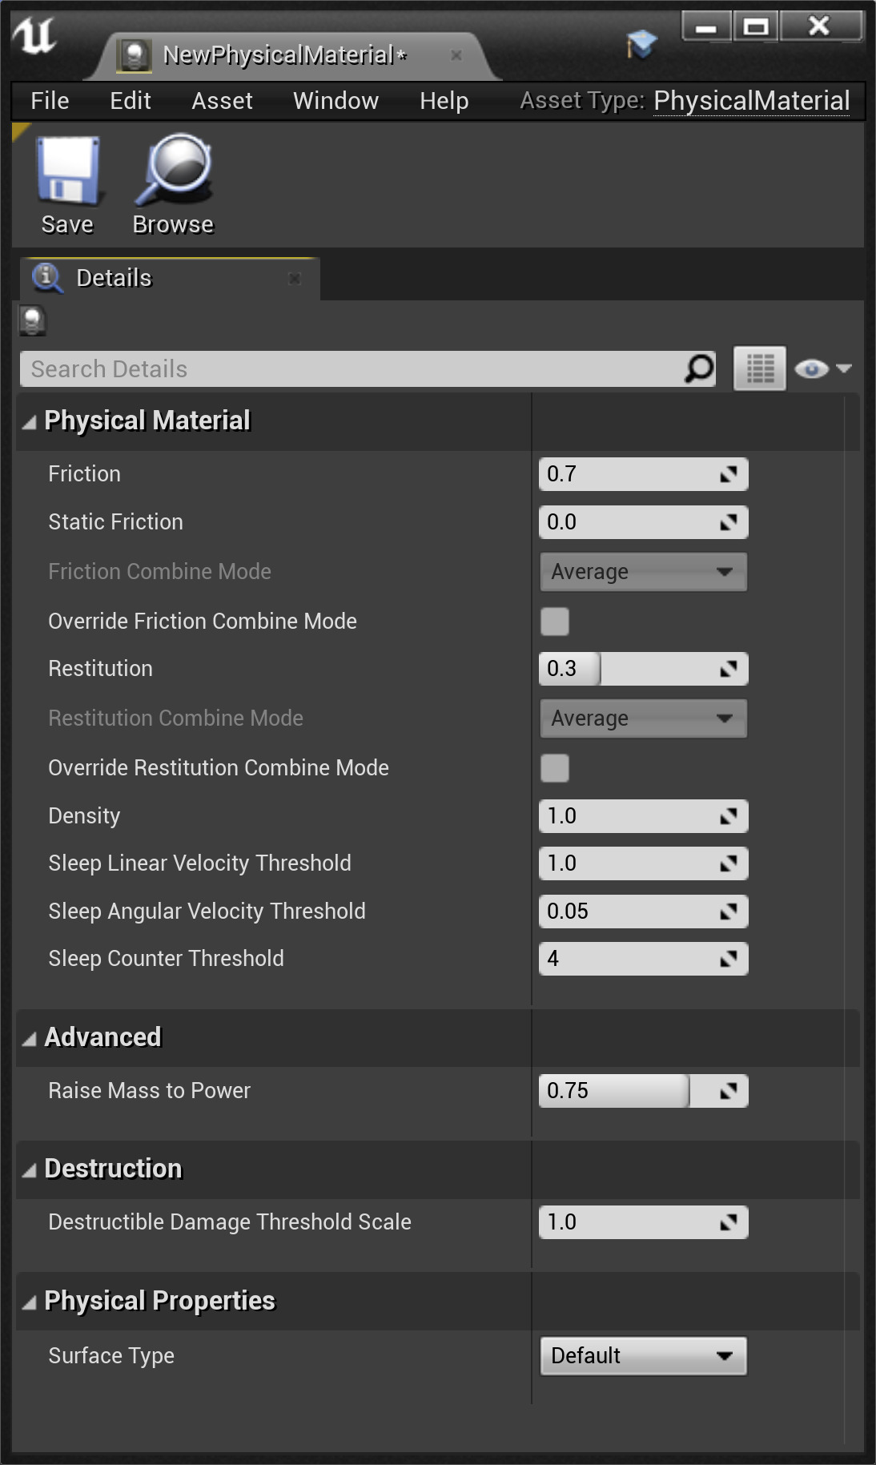
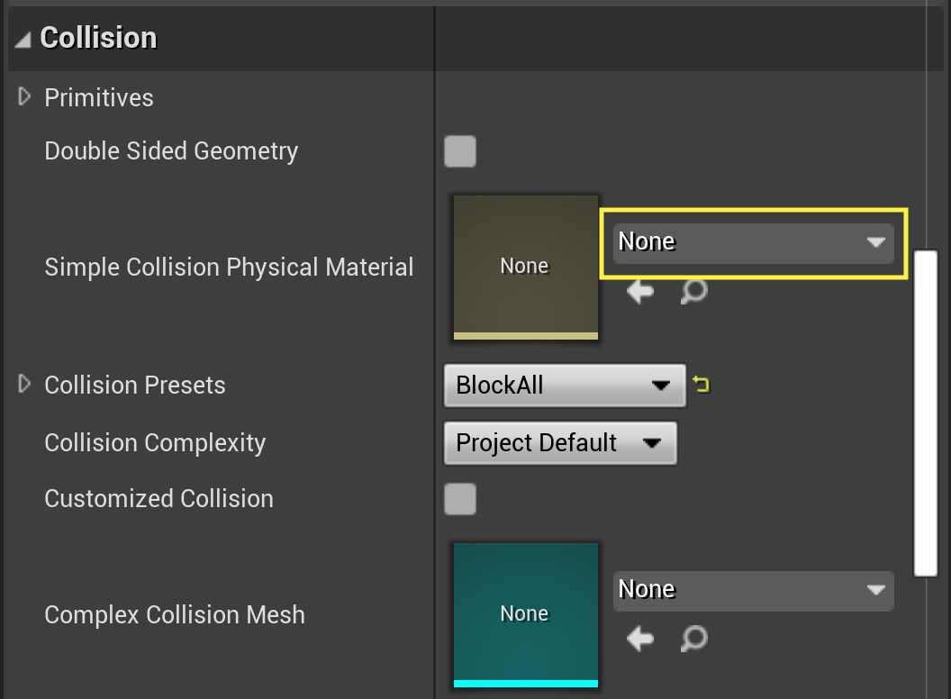
PHYSICS MATERIALS
Physical Materials are used to define the response of a physical object when interacting dynamically with the world.
Creating one will give you a set of default values, identical to the default physical material that is applied to all physics objects. Examples of this would be a character's dead body (ragdoll), a movable crate, and so on.

Slide 19
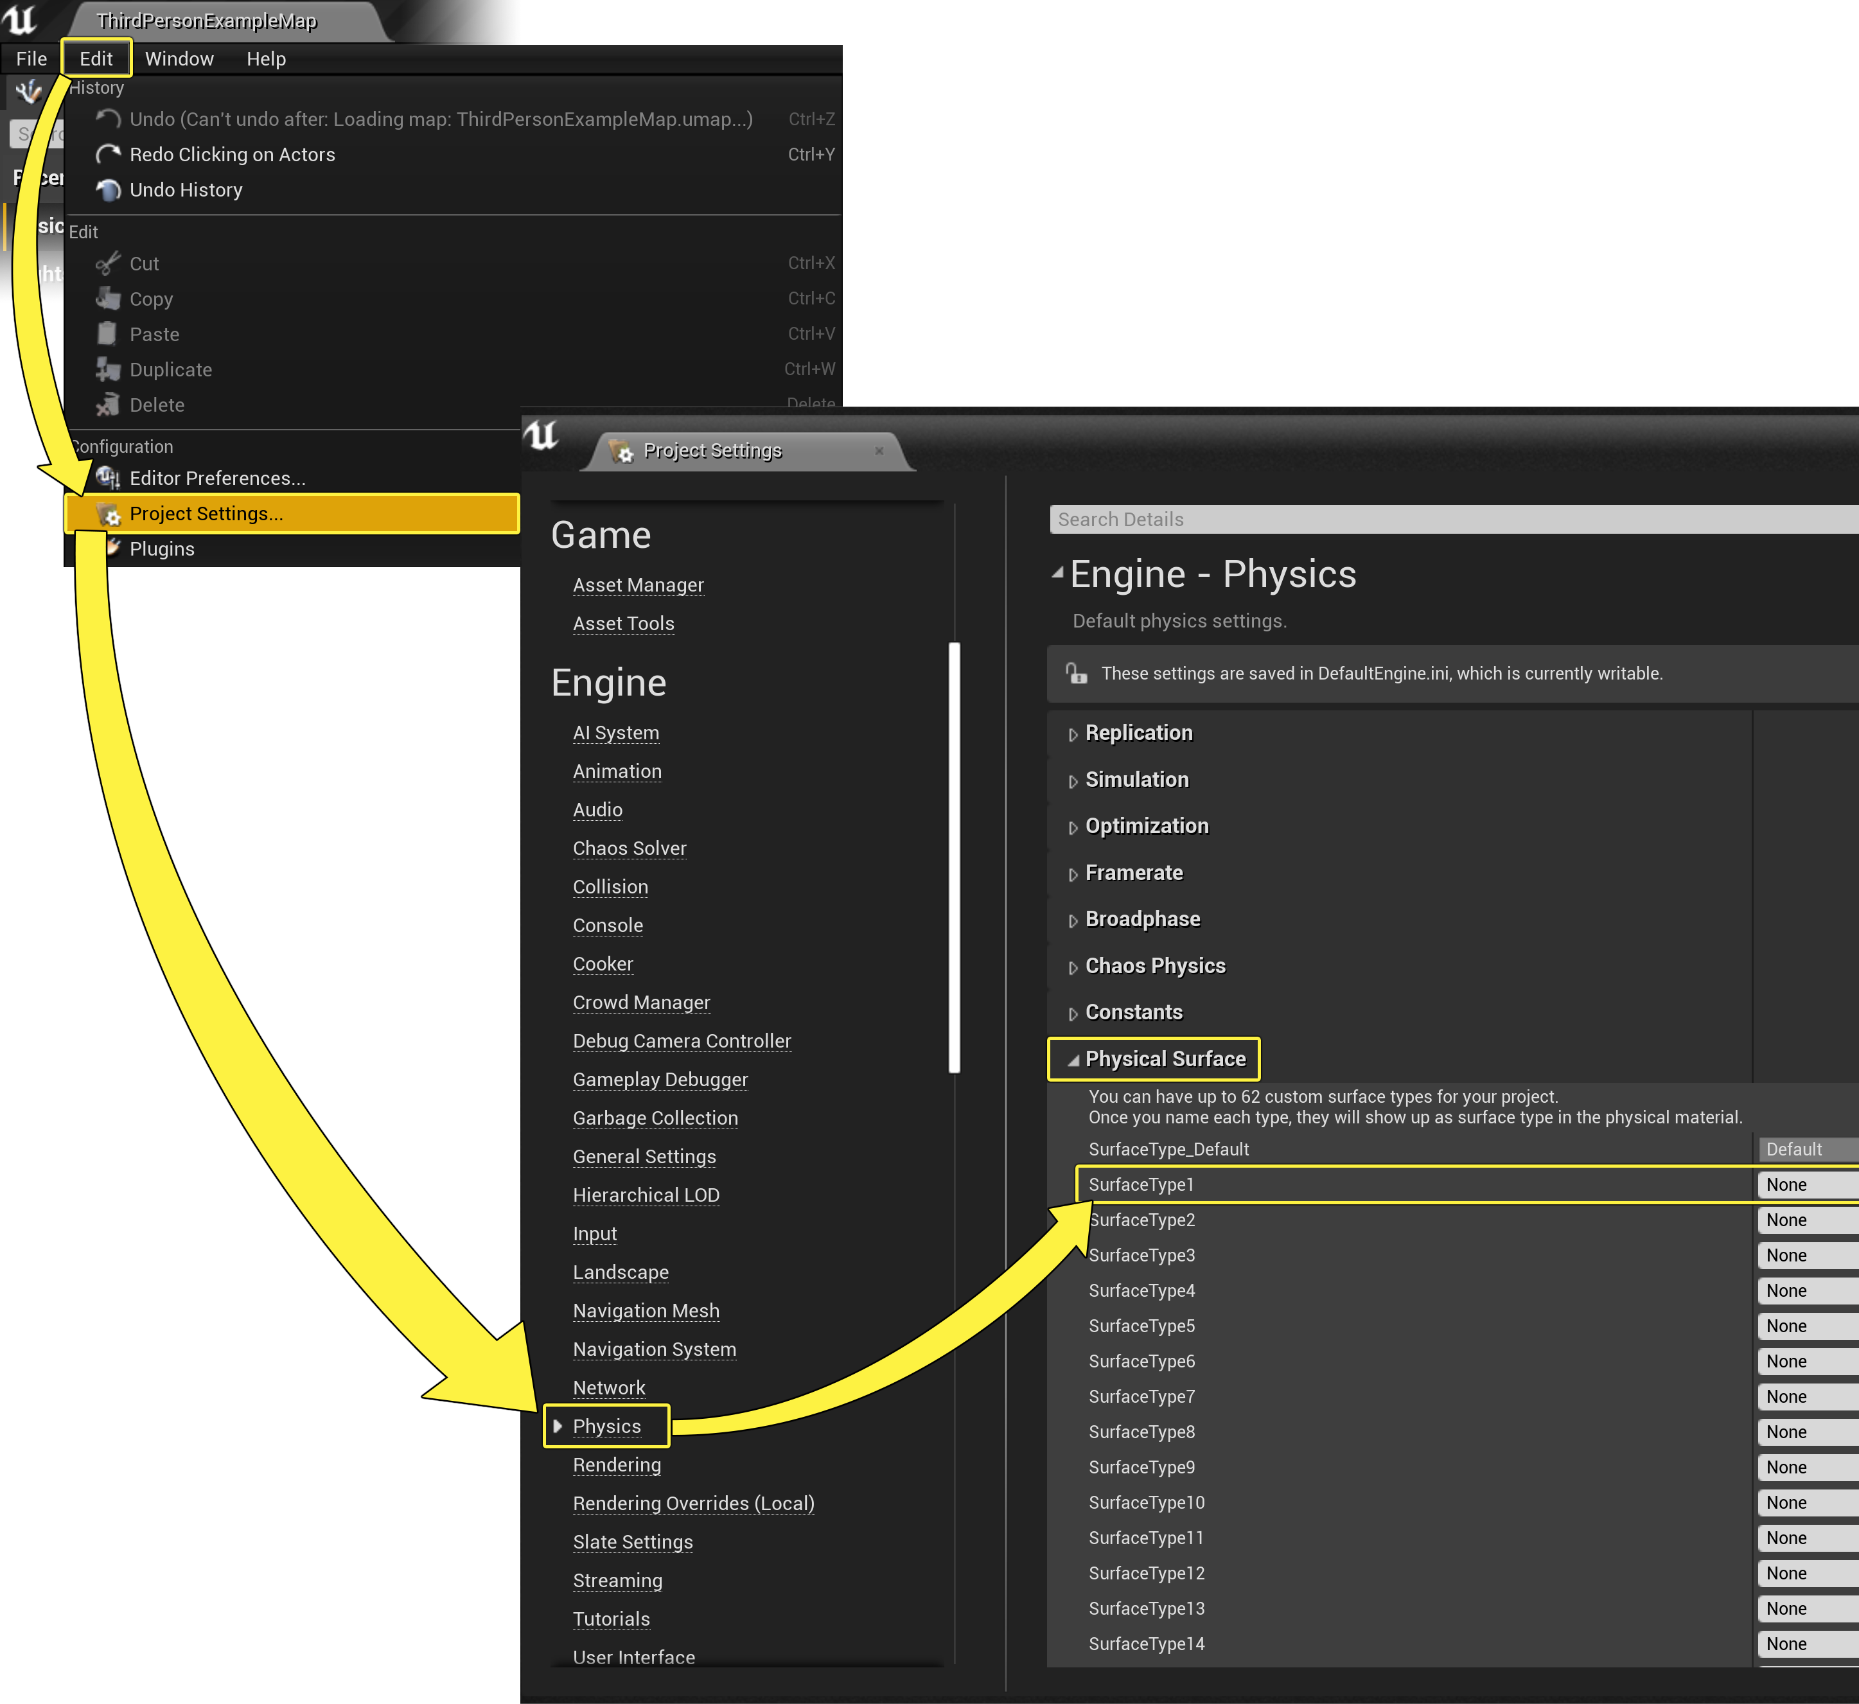
SURFACE TYPES
Physical Materials are used to define the response of a physical object when interacting dynamically with the world.
Creating one will give you a set of default values, identical to the default physical material that is applied to all physics objects. Examples of this would be a character's dead body (ragdoll), a movable crate, and so on.

Slide 20
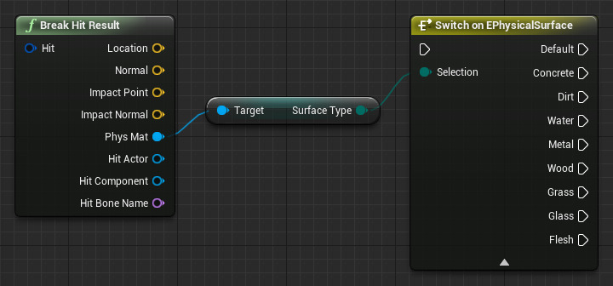
Property | Description
Friction | This is the friction value of the surface, which controls how easily things can slide on this surface.
Friction Combine Mode | This property enables you to adjust how Physical Material frictions are combined. This is set to Average by default, but can be overriden using the Override Friction Combine Mode property.
Override Friction Combine Mode | By default, the Friction Combine Mode is set to Average, by enabling this property you can change how Frictions are combined between touching Physical Materials.
Restitution | This is how "bouncy" the surface is, or how much energy it retains when it collides with another surface.
Restitution Combine Mode | This property enables you to adjust how Physical Material restitutions are combined. This is set to Average by default, but can be overriden using the Override Restitution Combine Mode property.
Override Restitution Combine Mode | By default, the Restitution Combine Mode is set to Average, by enabling this property you can change how Restitutions are combined between touching Physical Materials.
Density | Used with the shape of the object to calculate its mass properties. The higher the number, the heavier the object. Measured as g per cubic cm.
SURFACE TYPES
Surface Types are set in the DefaultEngine.ini file for your project.
They define an enum to be used in the engine for defining any number of things, from what sound plays as a character walks across a surface, to the type of decal an explosion should leave on different surfaces.

Slide 21
HINTS:
Consider using these nodes:
PhysicsConstraintComponent::BreakConstraint()
CableComponent::SetAttachEnd() / SetAttachEndTo()
PhysicsConstraintComponent::SetAngularDriveMode()
PhysicsConstraintComponent::SetAngularOrientationTarget()
PhysicsConstraintComponent::SetAngularDriveParams()
HOMEWORK:
BREAKABLE HANGING TRAPS
REQUIREMENTS:
Implement a BP_Hanging_Trap blueprint with a
sphere static mesh component
cable component
physics constraint.
Avatar should be able to attack and cut the cable in front of him/her. Then release the sphere and damage the enemies.
Cable component should also stop following the sphere after cutting.
Sphere should only damage when falling, rolling sphere shouldn’t damage enemies.
Prepare a scene to demonstrate your mechanics are working.
Sphere should swing harmonically.

Slide 22
Conclusion
Questions?

